Slide 1

U.S. Army - Application to improve project and process workflow
Braden Cariaga & Henry Thiel
10.07.2021

Slide 2

Agenda
INTRODUCTION
MEET OUR TEAM
SPONSOR DETAILS
PROJECT DESCRIPTION
PLANS MOVING FORWARD
CLOSING

Slide 3

INTRODUCTION
WHAT WAS TASKED TO US
Our team has been tasked with creating an enterprise application to improve process and project workflow which enables logisticians to populate the status of requirements and sub-requirements for project planning, material release and fielding, and post-fielding assessments.

Slide 4


Meet our team
COMPUTER SCIENCE
DATA ANALYTICS
BRADEN CARIAGA
HENRY THIEL
BEN BENYEHUDA
TIMOTHY GLISSON

Slide 5
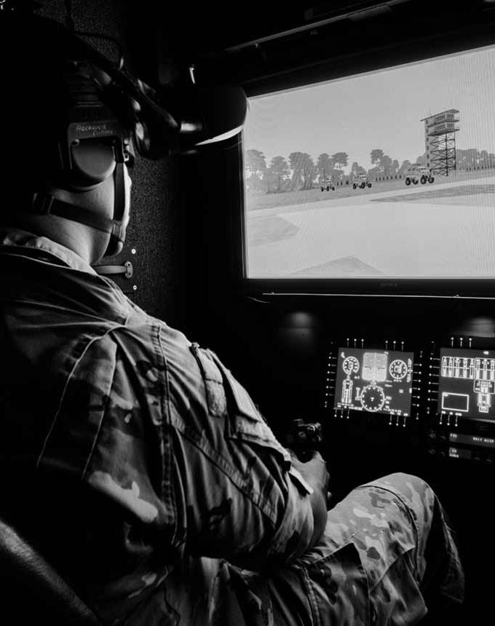
About PEO STRI
Program Executive Office Simulation, Training and Instrumentation
Subdivision of the US Army
Manage training and simulation
Aim to enhance and optimize readiness for military operations in the field
Currently use Email to approve materiel release and various training/simulation operations

Slide 6
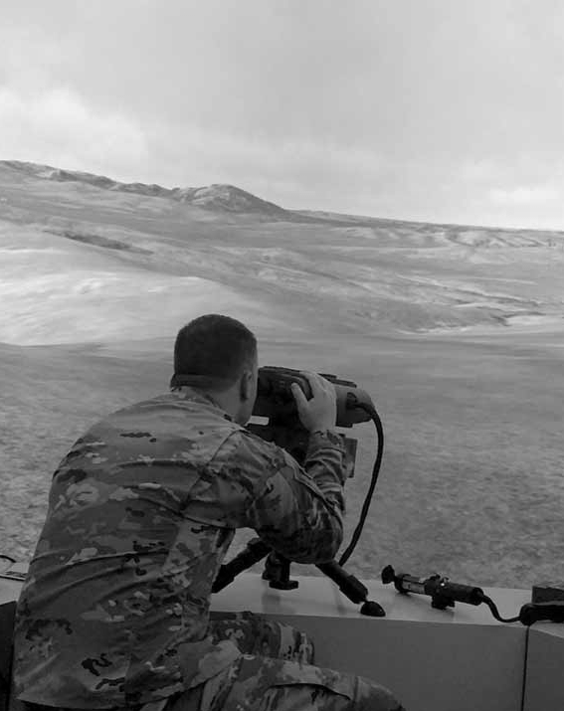
Project description
Enterprise solution, business process and application
Acquisitions logistics span many phases, each with sub-requirements to be tracked
Existing email system is lacking
No visibility to system state
No means to change digitally signed documents
Looking for new solutions
Approvers able to view metrics and data for fielding
Transparency to logistics status

Slide 7

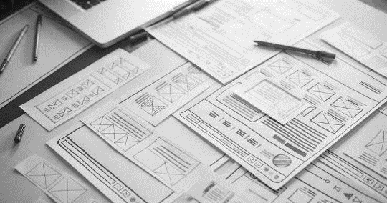
Plans Moving Forward
CONDUCTION OF INTERVIEWS
REQUIREMENTS ANALYSIS
Scheduled for Thursday afternoon
Many unanswered questions
Who will be using the system?
What types of simulations are conducted?
What materiel and paperwork needs to be tracked?
Where does the system need to be accessed from?
Etc.
Clients rarely state need
Must analyze their answers for functional and nonfunctional requirements
Assign timelines to each requirement based on priority
Conduct market analysis to compare to third-party solutions

Slide 8

SUMMARY
OUR SPONSOR IS THE U.S. ARMY
Program Executive Office for Simulation, Training and Instrumentation
OUR PROJECT IS AN
Application to Improve Project and Process Workflow
OUR TEAM NEEDS TO CREATE
An enterprise solution to enable Logisticians to easily populate status of sub-requirements, which feed into the high-level requirements for product support planning, material release, material fielding, property transfer, and post fielding sustainment assessments.
MOVING FORWARD, WE PLAN TO
Interview the sponsor on Thursday (10/07) and perform a requirements analysis on the information received.

Slide 9

THANK YOU! Any questions?
BRADEN CARIAGA
HENRY THIEL
U.S. ARMY PROCESS WORKFLOW APP

